Slide 1
Project Steering Committee
Windhoek, 14 June 2018
“Support to MoHSS for accelerated implementation of GFATM”
Project Number: 00102753
Project start date: 3 February 2017
Project current end date: 30 June 2018
Reporting period: Q1 2018

Slide 2
Overview:
Financing Agreement (previously named Cost Sharing Agreement) 2017: revised final financial report
Financing Agreement 2018: quarterly progress update
Results
Detailed Expenditure Report – Q1 2018
Implementation details - Q1 and Q2 2018
Challenges and action taken
Risk Management Plan update
3. Project Extension 2018: proposed budget
4. Decisions for the Project Steering Committee: budget revision
5. Way forward

Slide 3
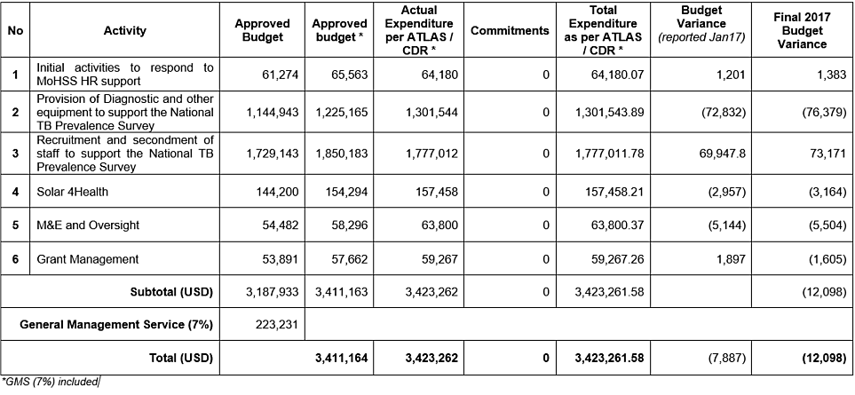
Financing Agreement 2017: revised final financial report

Slide 4
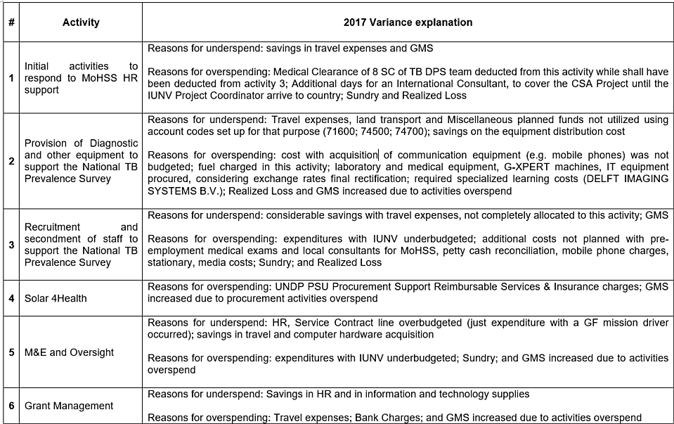

Slide 5
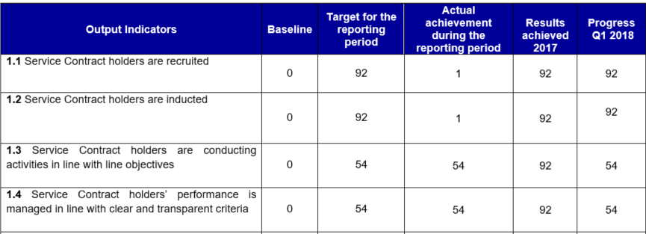
2. Financing Agreement 2018: Results output 1
Activity: Recruitment and secondment of staff to support the National TB Prevalence Survey
Output 1: MoHSS has increased human resource capacity to conduct activities under GF Grants
Results Achieved: Human resource capacity of MoHSS to conduct TB Prevalence Survey under the GF grant has increased
Achievement ratio: 100%

Slide 6
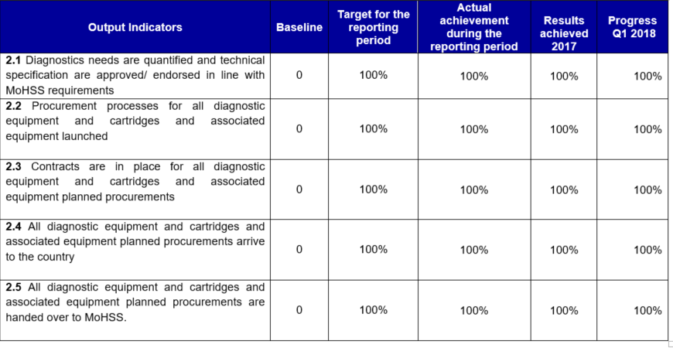
2. Financing Agreement 2018: Results output 2
Activity: Provision of Diagnostic and other equipment to support the National TB Prevalence Survey
Output 2: MoHSS has sufficient logistics capacity to undertaken TB Prevalence Survey
Results Achieved: Logistics capacity of MoHSS to undertake TB Prevalence Survey is sufficient
Achievement ratio: 100%
Activity completed.

Slide 7
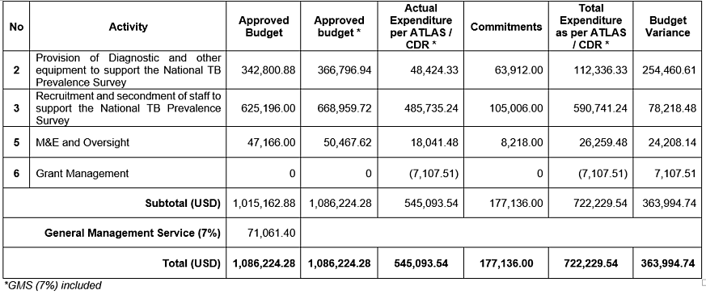
2. Financing Agreement 2018: Q1 Detailed Expenditure Report

Slide 8
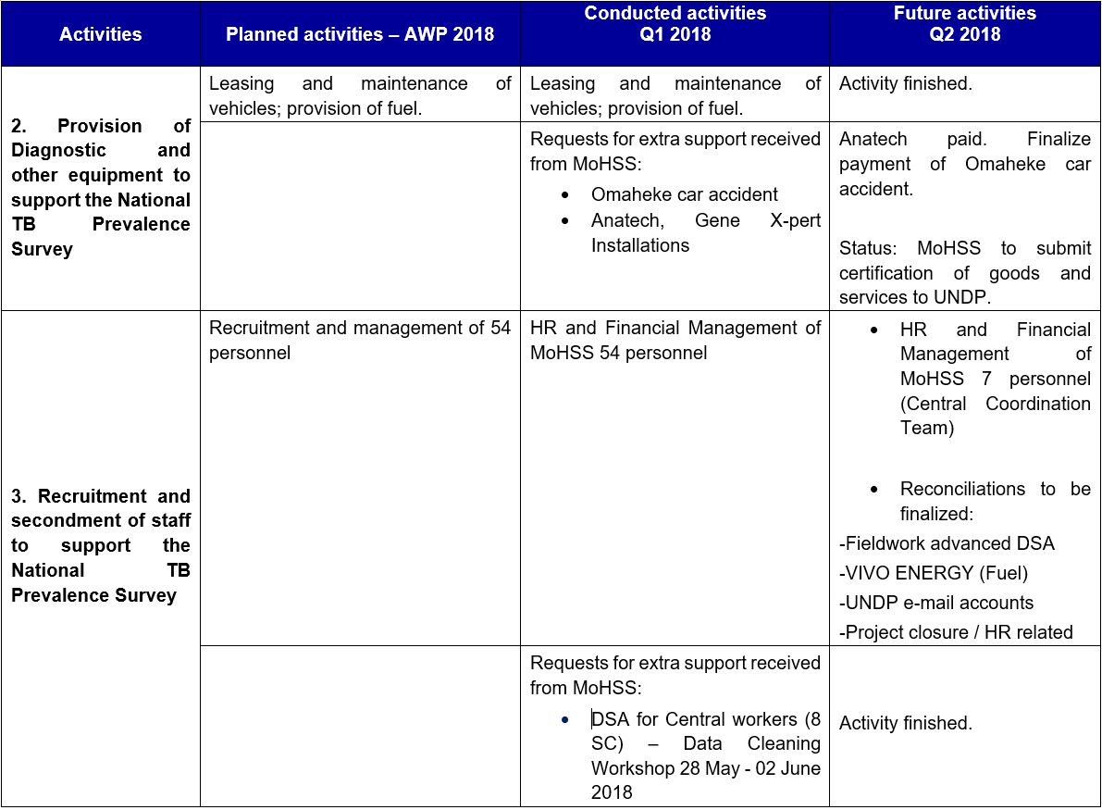
2. Financing Agreement 2018: Implementation details Q1 & Q2

Slide 9
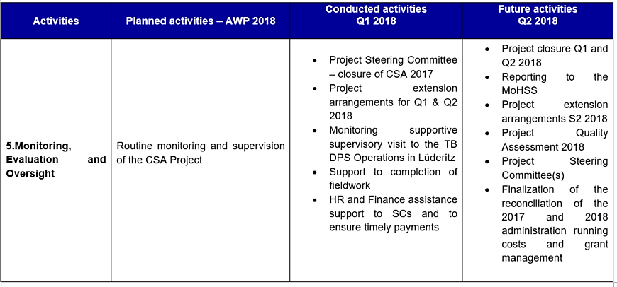
2. Financing Agreement 2018: Implementation details Q1 & Q2

Slide 10
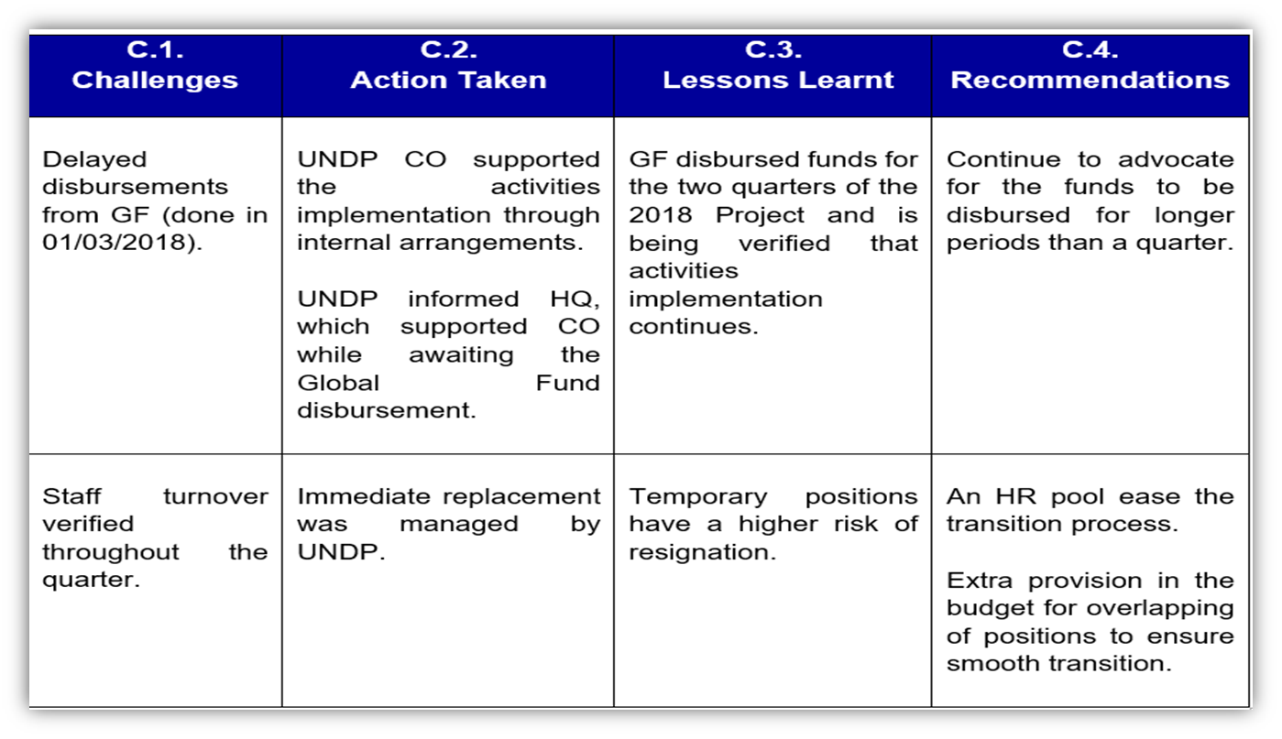
2. Financing Agreement 2018: challenges and solutions

Slide 11
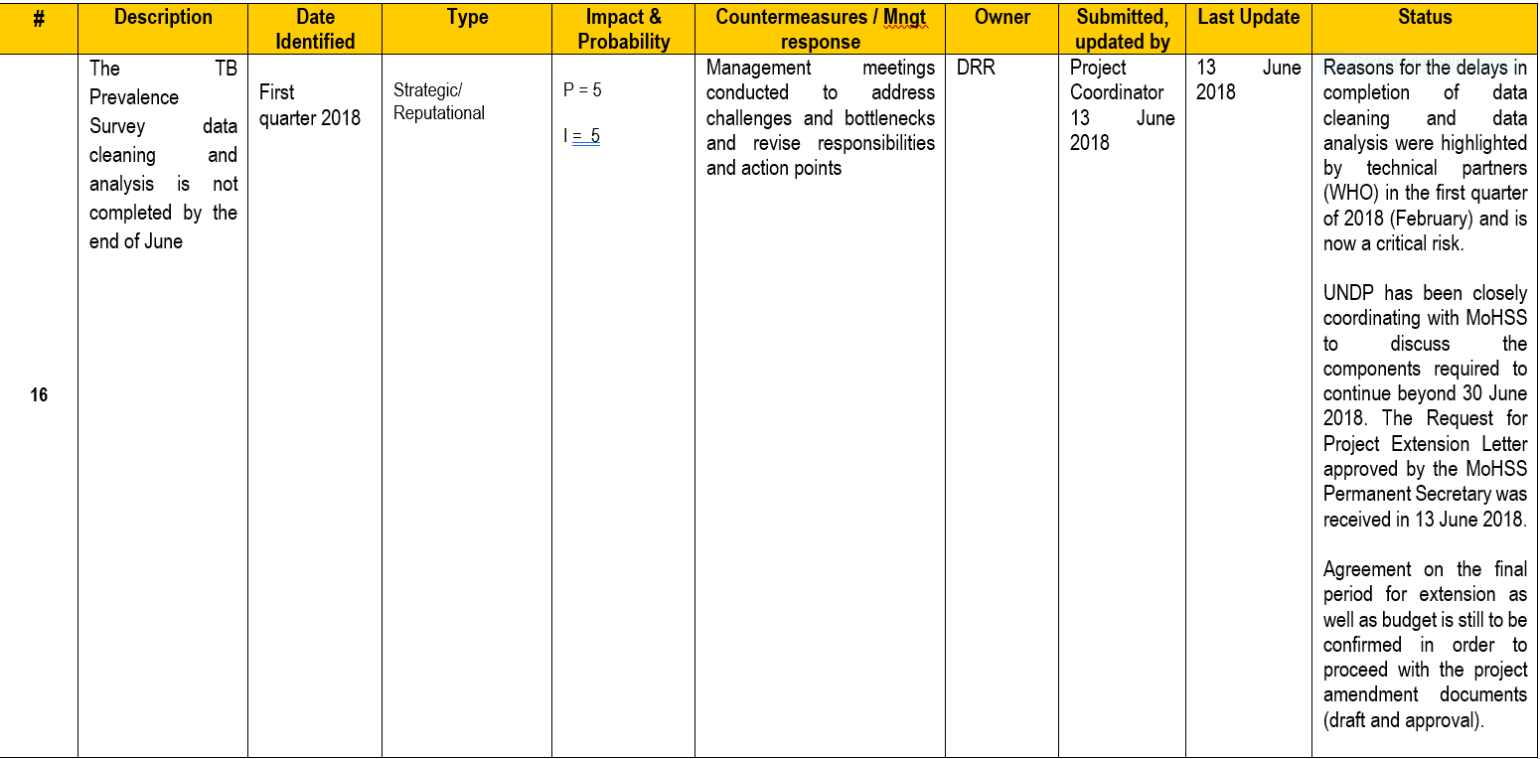
2. Financing Agreement 2018: Risk Management Plan update

Slide 12
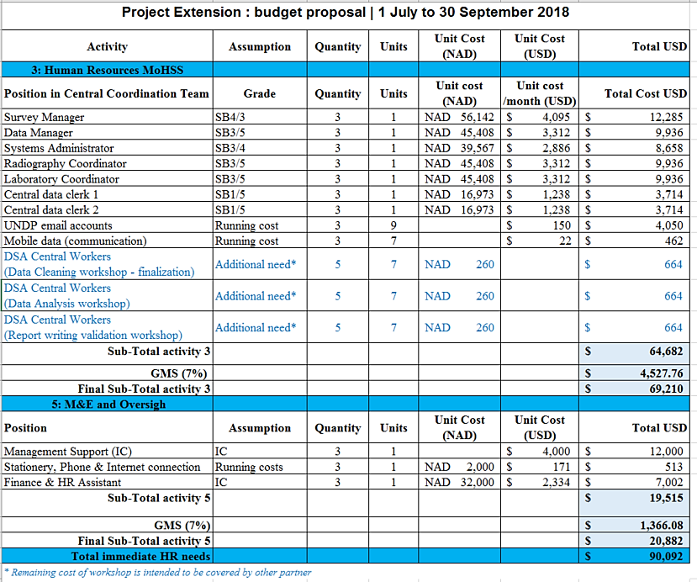

Slide 13
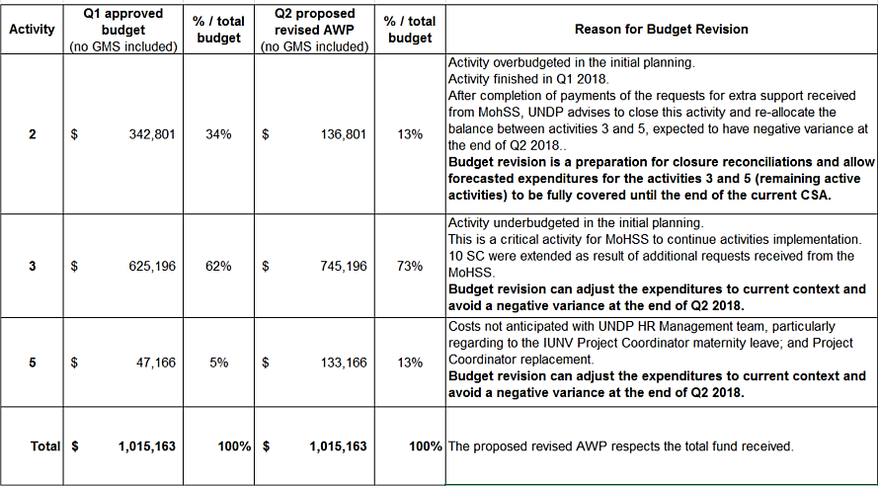
4. Decisions for the Project Steering Committee: budget revision

Slide 14
5. Way forward
Project Extension Roadmap | Expected by
TB DPS 7 SC staff contracts amendments | tbd/new fund
Response Letter to MoHSS Request for Project Extension | 18 June
Financing Agreement Amendment: send to MoHSS PMU | 21 June
PRODOC amendment: send to MoHSS PMU | 27 June
Project Closure Roadmap | Expected by
Reporting Jan-June 2018 Financing Agreement (narrative, treasury/financial reports) | 2 July
Project Steering Committee: closure of Jan-June 2018 | 4 July
Project extension approval and signature, pending:
Confirmation of period of extension
Evaluation of other components to be included (e.g. Solar 4Health; technical support; capacity development)
Decision on budget for the additional disbursement
Financing Agreement amendment approval
Project Document extension approval (revised AWP to include new components)

